Slide 1
Mapping Requirements into a Software Architecture

Slide 2
An Architectural Design Method
customer requirements
"four bedrooms, lounge, drawing & dinning,
lots of glass ..."
architectural design

Slide 3
Mapping Requirements Into a Software Architecture
Earlier had said certain models can be mapped directing into
an architectural design
  methods do not exist for all architectural styles
  Will look at 1 approach for the call & return architecture sometimes called structured design - origins in top-down design [WIR71], structured programming [DAH72],
    SD is a data-flow oriented design method
      Provides a method to go from a DFD to program structure

Slide 4
Deriving Program Architecture
Program
Architecture

Slide 5
Structured Design
objective: develop a modular program structure and represent control relationships between modules
approach:
  the DFD is mapped into a program architecture
  the PSPEC and STD are used to indicate the content of each module
notation: structure chart

Slide 6
Structured Design
It provides a convenient transition from a data flow diagram to software Architecture
  The type of information flow is established
  Flow boundaries are indicated
  The DFD is mapped into program structure
  Control hierarchy is defined
  Resultant structure is refined using design measures and heuristics
  The architectural description is refined and elaborated

Slide 7
Types of Information Flow
There are 2 different types of information flow that have different treatments
  Transform flow - Overall DF in sequential manner and follows one, or only a few, “straight line” paths. (incoming, transform, output)
  Transaction Flow - Info flow has a single transaction node that triggers other data flow

Slide 8
Transform Flow
  Incoming Flow: The paths that transform the external data into an internal form
  Transform Center: The incoming data are passed through a transform center and begin to move along paths that lead it out of the software
  Outgoing Flow: The paths that move the data out of the software
Transform flow

Slide 9
Transform Analysis: mapping heuristic
i1
tc1
o1
o2
i2
tc2
o3
sys
I-ctrl
P-ctrl
O-ctrl
i1
i2
tc1
tc2
o1
o3
o2

Slide 10
Transaction Flow
  Information flow is often characterized by a single data item, called a transaction that triggers other data flow along one of many paths
  Action Paths :The transaction is evaluated and based on its value flow along one of many action paths
  Transaction center :The hub of info flow from which many action paths originate
Transaction
flow

Slide 11
Transaction Analysis: mapping heuristic
r1
sys
r2
trc
r2
trc
r1
s1
s2
i1
i2
i1
cot
o1
cot
i2
o1

Slide 12
Transform Mapping (cont)
Design steps
  Step 1. Review the fundamental system model.
  Step 2. Review and refine data flow diagrams for the software.
  Step 3. Determine whether DFD has transform or transaction flow characteristics.
    in general---transform flow
    special case---transaction flow

Slide 13
Transform Mapping (cont)
Step 4. Isolate the transform center by specifying incoming and outgoing flow boundaries
  different designers may select slightly differently
  transform center can contain more than one bubble.
Step 5. Perform “first-level factoring”
  program structure represent a top-down distribution control.
  factoring results in a program structure(top-level, middle-level, low-level)
  number of modules limited to minimum.

Slide 14
Transform Mapping (cont)
  Step 6. Perform “second-level factoring”
    mapping individual transforms(bubbles) to appropriate modules.
    factoring accomplished by moving outwards from transform center boundary.
  Step 7. Refine the first iteration program structure using design heuristics for improved software quality.

Slide 15
Transaction Mapping Design
Step 1.Review the fundamental system model.
Step 2.Review and refine DFD for the software
Step 3.Determine whether the DFD has transform or transaction flow characteristics
Step 4. Identify the transaction center and flow characteristics along each of the action paths
    isolate incoming path and all action paths
    each action path evaluated for its flow characteristic.

Slide 16
Transaction Mapping (cont)
Step 5. Map the DFD in a program structure amenable to transaction processing
  incoming branch
    bubbles along this path map to modules
  dispatch branch
    dispatcher module controls all subordinate action modules
    each action path mapped to corresponding structure

Slide 17
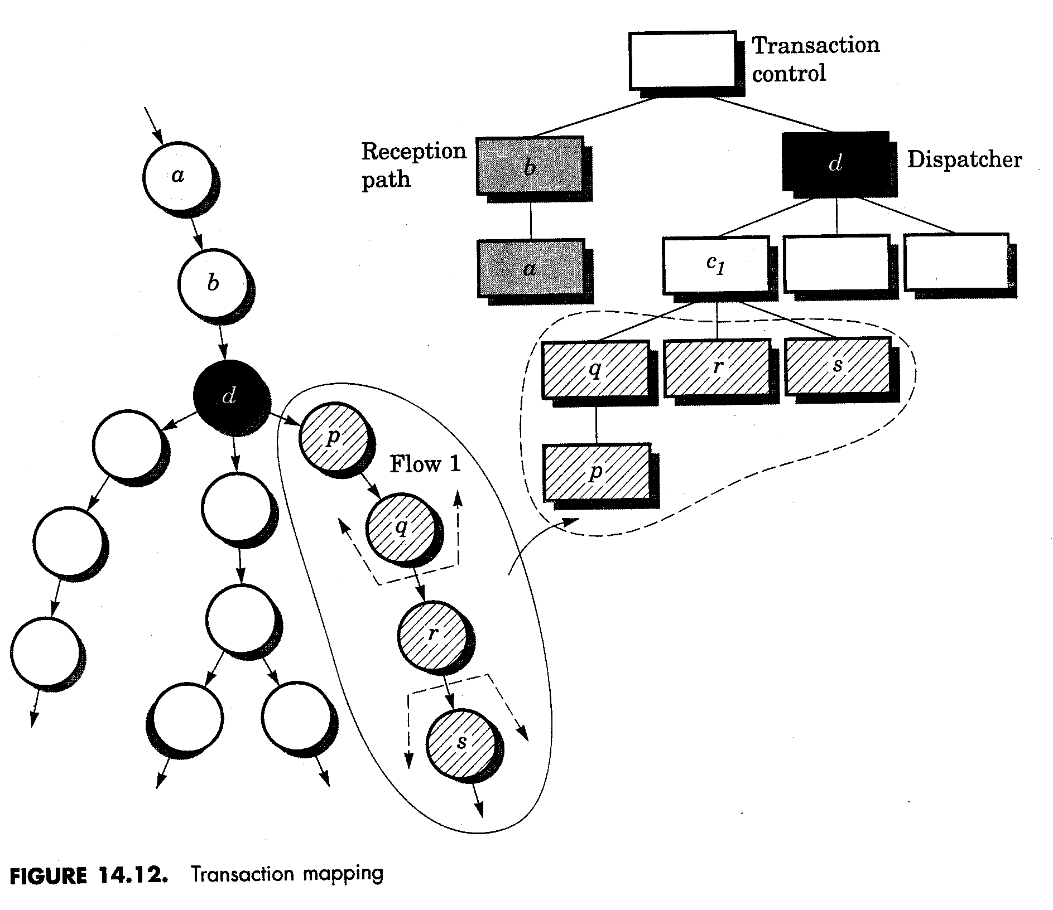
Transaction Mapping

Slide 18
Transaction Mapping (cont)
step 6. Factor and refine the transaction structure and the structure of each action path
step 7. Refine the first iteration program structure using design heuristics for improved software quality

Slide 19
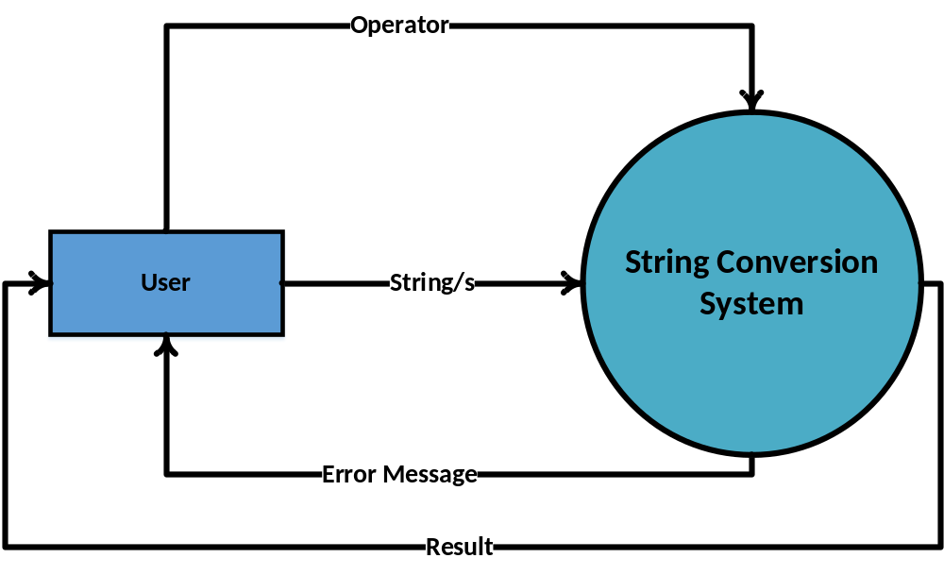
String Conversion System: Context Level DFD

Slide 20
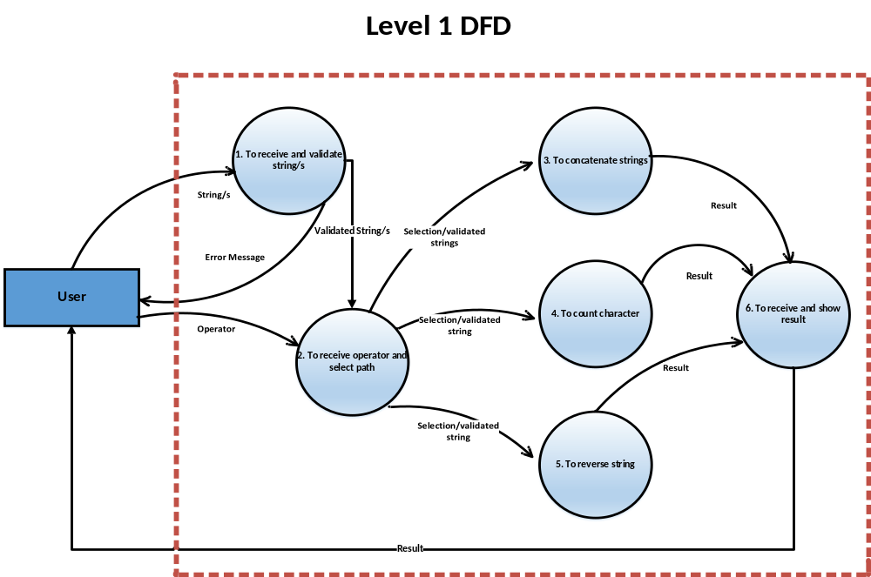
String Conversion System

Slide 21
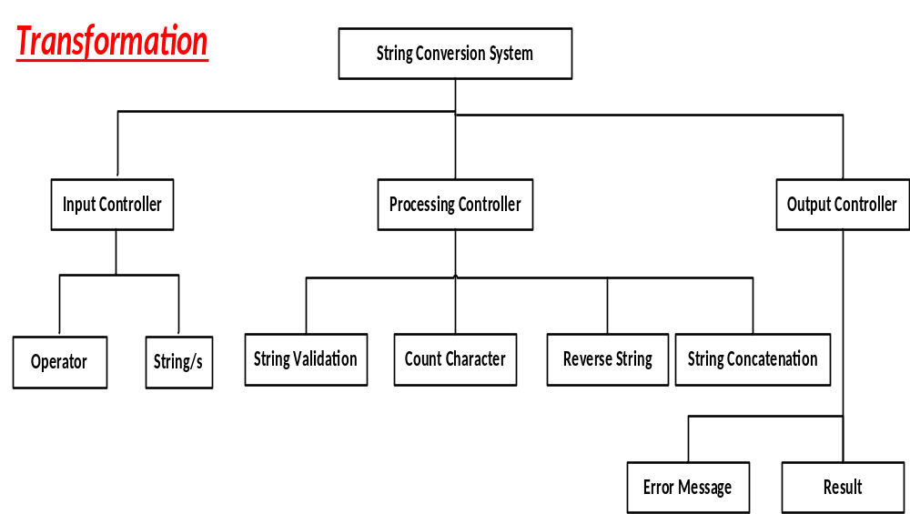

Slide 22
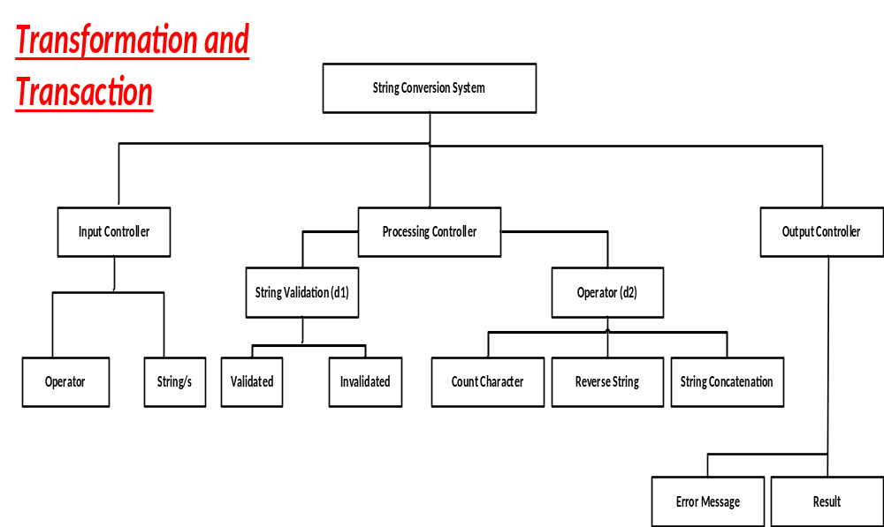

Slide 23
